Slide 1
A Random Oracle is subject to three types of attacks
INSERT
VIDEO
HERE

Slide 2
A Random Oracle is subject to three types of attacks
Attacks against a Random Oracle
INSERT
VIDEO
HERE

Slide 3
A Random Oracle is subject to three types of attacks
Attacks against a Random Oracle
Preimage attack
INSERT
VIDEO
HERE

Slide 4
A Random Oracle is subject to three types of attacks
Attacks against a Random Oracle
Preimage attack
Second preimage attack
INSERT
VIDEO
HERE

Slide 5
A Random Oracle is subject to three types of attacks
Attacks against a Random Oracle
Preimage attack
Second preimage attack
Hash collision (birthday) attack
INSERT
VIDEO
HERE

Slide 6
A Random Oracle is subject to three types of attacks
Attacks against a Random Oracle
Preimage attack
Second preimage attack
Hash collision (birthday) attack
Real hash functions vulnerable to other attacks
INSERT
VIDEO
HERE

Slide 7
Brute force attacks against a hash function are exponentially difficult
INSERT
VIDEO
HERE

Slide 8
Brute force attacks against a hash function are exponentially difficult
N-bit hash function has 2^{N} possible digests
INSERT
VIDEO
HERE

Slide 9
Brute force attacks against a hash function are exponentially difficult
N-bit hash function has 2^{N} possible digests
Brute force attacks search digest space
INSERT
VIDEO
HERE

Slide 10
Brute force attacks against a hash function are exponentially difficult
N-bit hash function has 2^{N} possible digests
Brute force attacks search digest space
Atoms in universe – 10⁸⁰ or 2²⁶⁵
INSERT
VIDEO
HERE

Slide 11
Brute force attacks against a hash function are exponentially difficult
N-bit hash function has 2^{N} possible digests
Brute force attacks search digest space
Atoms in universe – 10⁸⁰ or 2²⁶⁵
At 1 atom/bit:
INSERT
VIDEO
HERE

Slide 12
Brute force attacks against a hash function are exponentially difficult
N-bit hash function has 2^{N} possible digests
Brute force attacks search digest space
Atoms in universe – 10⁸⁰ or 2²⁶⁵
At 1 atom/bit:
256-bit hash requires half the mass of universe
INSERT
VIDEO
HERE

Slide 13
Brute force attacks against a hash function are exponentially difficult
N-bit hash function has 2^{N} possible digests
Brute force attacks search digest space
Atoms in universe – 10⁸⁰ or 2²⁶⁵
At 1 atom/bit:
256-bit hash requires half the mass of universe
Atoms in a grain of sand – 10²⁰ or 2⁶⁶
INSERT
VIDEO
HERE

Slide 14
Brute force attacks against a hash function are exponentially difficult
N-bit hash function has 2^{N} possible digests
Brute force attacks search digest space
Atoms in universe – 10⁸⁰ or 2²⁶⁵
At 1 atom/bit:
256-bit hash requires half the mass of universe
Atoms in a grain of sand – 10²⁰ or 2⁶⁶
64-bit hash function ≈ 12 grains of sand
INSERT
VIDEO
HERE

Slide 15
Brute force attacks against a hash function are exponentially difficult
N-bit hash function has 2^{N} possible digests
Brute force attacks search digest space
Atoms in universe – 10⁸⁰ or 2²⁶⁵
At 1 atom/bit:
256-bit hash requires half the mass of universe
Atoms in a grain of sand – 10²⁰ or 2⁶⁶
64-bit hash function ≈ 12 grains of sand
One million digests per second
INSERT
VIDEO
HERE

Slide 16
Brute force attacks against a hash function are exponentially difficult
N-bit hash function has 2^{N} possible digests
Brute force attacks search digest space
Atoms in universe – 10⁸⁰ or 2²⁶⁵
At 1 atom/bit:
256-bit hash requires half the mass of universe
Atoms in a grain of sand – 10²⁰ or 2⁶⁶
64-bit hash function ≈ 12 grains of sand
One million digests per second
Enumerate 64-bit hash in half a million years
INSERT
VIDEO
HERE

Slide 17
A preimage attack attempts to find a message having a specific digest
INSERT
VIDEO
HERE

Slide 18
A preimage attack attempts to find a message having a specific digest
Try random messages looking for target digest
INSERT
VIDEO
HERE

Slide 19

A preimage attack attempts to find a message having a specific digest
Try random messages looking for target digest
Chance of success per attempt: $\frac{1}{D}$
INSERT
VIDEO
HERE

Slide 20

A preimage attack attempts to find a message having a specific digest
Try random messages looking for target digest
Chance of success per attempt: $\frac{1}{D}$
Chance of failure after k attempts
INSERT
VIDEO
HERE

Slide 21
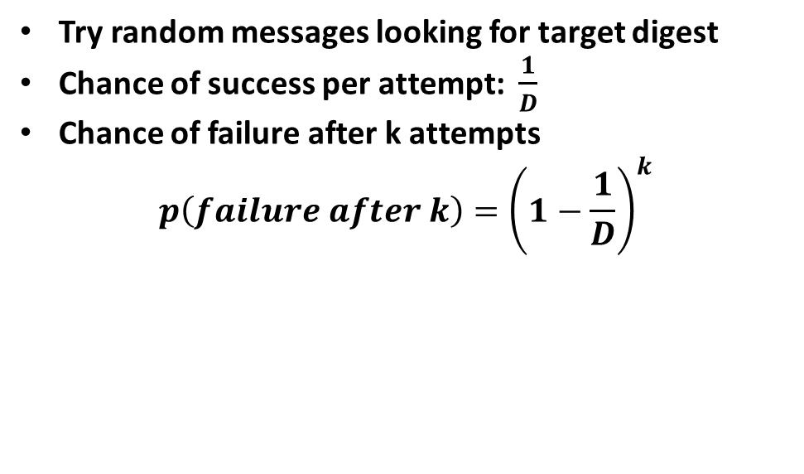
A preimage attack attempts to find a message having a specific digest
Try random messages looking for target digest
Chance of success per attempt: $\frac{1}{D}$
Chance of failure after k attempts
$$p\left(failure after k\right)={\left(1−\frac{1}{D}\right)}^{k}$$
INSERT
VIDEO
HERE

Slide 22
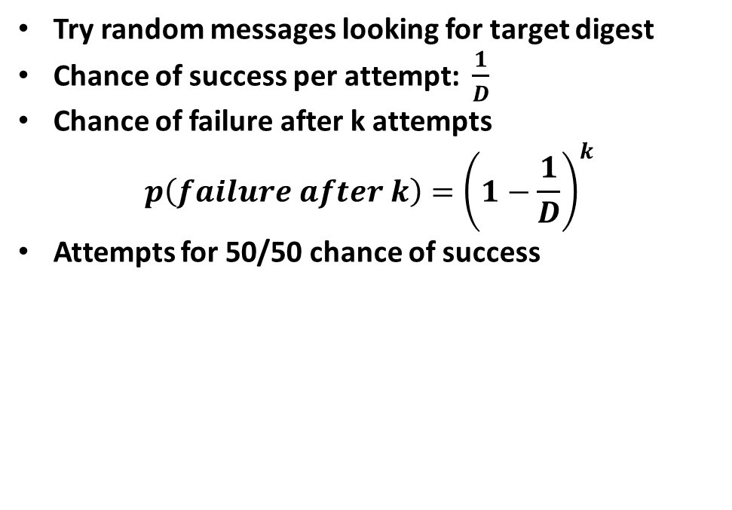
A preimage attack attempts to find a message having a specific digest
Try random messages looking for target digest
Chance of success per attempt: $\frac{1}{D}$
Chance of failure after k attempts
$$p\left(failure after k\right)={\left(1−\frac{1}{D}\right)}^{k}$$
Attempts for 50/50 chance of success
INSERT
VIDEO
HERE

Slide 23
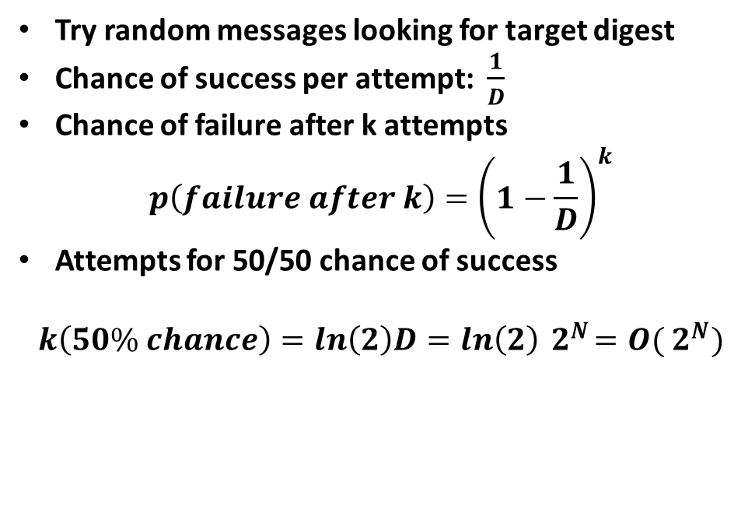
A preimage attack attempts to find a message having a specific digest
Try random messages looking for target digest
Chance of success per attempt: $\frac{1}{D}$
Chance of failure after k attempts
$$p\left(failure after k\right)={\left(1−\frac{1}{D}\right)}^{k}$$
Attempts for 50/50 chance of success
$$k\left(50\% chance\right)=ln\left(2\right)D=ln\left(2\right){ 2}^{N}=O({ 2}^{N})$$
INSERT
VIDEO
HERE

Slide 24
Preimage attacks against good hash functions are computationally infeasible
Attacks on 64-bit hash functions barely feasible
INSERT
VIDEO
HERE

Slide 25
Preimage attacks against good hash functions are computationally infeasible
Attacks on 64-bit hash functions barely feasible
Most current hash functions 128, 256 bits or more
INSERT
VIDEO
HERE

Slide 26
Preimage attacks against good hash functions are computationally infeasible
Attacks on 64-bit hash functions barely feasible
Most current hash functions 128, 256 bits or more
Large hash functions CAN be vulnerable
INSERT
VIDEO
HERE

Slide 27
Preimage attacks against good hash functions are computationally infeasible
Attacks on 64-bit hash functions barely feasible
Most current hash functions 128, 256 bits or more
Large hash functions CAN be vulnerable
Simple “perfect hashes” are trivially broken
INSERT
VIDEO
HERE

Slide 28
Preimage attacks against good hash functions are computationally infeasible
Attacks on 64-bit hash functions barely feasible
Most current hash functions 128, 256 bits or more
Large hash functions CAN be vulnerable
Simple “perfect hashes” are trivially broken
Key lessons
INSERT
VIDEO
HERE

Slide 29
Preimage attacks against good hash functions are computationally infeasible
Attacks on 64-bit hash functions barely feasible
Most current hash functions 128, 256 bits or more
Large hash functions CAN be vulnerable
Simple “perfect hashes” are trivially broken
Key lessons
Large hash does not imply secure hash
INSERT
VIDEO
HERE

Slide 30
Preimage attacks against good hash functions are computationally infeasible
Attacks on 64-bit hash functions barely feasible
Most current hash functions 128, 256 bits or more
Large hash functions CAN be vulnerable
Simple “perfect hashes” are trivially broken
Key lessons
Large hash does not imply secure hash
Weaknesses that CAN exist, WILL exist
INSERT
VIDEO
HERE

Slide 31
Second Preimage attacks are “usually” equivalent to a preimage attack
INSERT
VIDEO
HERE

Slide 32
Second Preimage attacks are “usually” equivalent to a preimage attack
Reduces to preimage attack with Random Oracle
INSERT
VIDEO
HERE

Slide 33
Second Preimage attacks are “usually” equivalent to a preimage attack
Reduces to preimage attack with Random Oracle
Effort is O(2^{N})
INSERT
VIDEO
HERE

Slide 34
Second Preimage attacks are “usually” equivalent to a preimage attack
Reduces to preimage attack with Random Oracle
Effort is O(2^{N})
Perfect hash is immune to second preimage attack
INSERT
VIDEO
HERE

Slide 35
Second Preimage attacks are “usually” equivalent to a preimage attack
Reduces to preimage attack with Random Oracle
Effort is O(2^{N})
Perfect hash is immune to second preimage attack
Subtle but important distinction
INSERT
VIDEO
HERE

Slide 36
Second Preimage attacks are “usually” equivalent to a preimage attack
Reduces to preimage attack with Random Oracle
Effort is O(2^{N})
Perfect hash is immune to second preimage attack
Subtle but important distinction
Real hash functions probably have traces of it
INSERT
VIDEO
HERE

Slide 37
Second Preimage attacks are “usually” equivalent to a preimage attack
Reduces to preimage attack with Random Oracle
Effort is O(2^{N})
Perfect hash is immune to second preimage attack
Subtle but important distinction
Real hash functions probably have traces of it
Adversaries will seek them out
INSERT
VIDEO
HERE

Slide 38
Second Preimage attacks are “usually” equivalent to a preimage attack
Reduces to preimage attack with Random Oracle
Effort is O(2^{N})
Perfect hash is immune to second preimage attack
Subtle but important distinction
Real hash functions probably have traces of it
Adversaries will seek them out
Our design needs to treat them separately
INSERT
VIDEO
HERE

